Slide 1
All About Tor

Slide 2
Agenda
What is Tor
Downloading and using Tor Browser
Even more Tor Browser
Using mobile Tor
Getting help using Tor

Slide 3
More agenda – maybe today, maybe tomorrow
Circumventing censorship with Tor
Sharing content securely/anonymously with Tor onion services
OnionShare
More from the Tor world: Tails, Brave Browser, SecureDrop

Slide 4
Me and Tor
How and why I got involved with Tor
What I do there now
Tor and libraries

Slide 5
You and Tor
Do you use Tor?
Do you teach others about Tor?
What have you heard about Tor?
Questions, concerns, doubts about Tor?

Slide 6
What is Tor?
What do YOU think it is?
Free software and an open network
Mitigates against surveillance and censorship
Run by a US non-profit and volunteers from all over the world
It’s Tor, not TOR

Slide 7
little-t Tor or core tor
Tor the network daemon (a computer program)
Presents a SOCKS or http proxy
Location and source anonymity, similar to a VPN or regular proxy (but better!)
Network of relays in many parts of the world

Slide 8
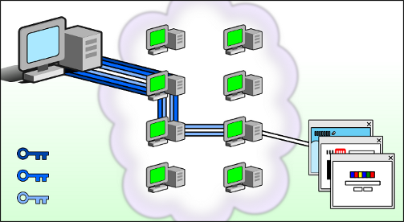
How Tor relays work

Slide 9
Tor Browser
little-t tor plus patched Firefox
Anyone snooping can’t see the websites you visit
Websites can’t track you or see other sites you visit
Prevents other privacy violations like fingerprinting or 3rd party cookies
Writes nearly nothing to disk
No browser history

Slide 10
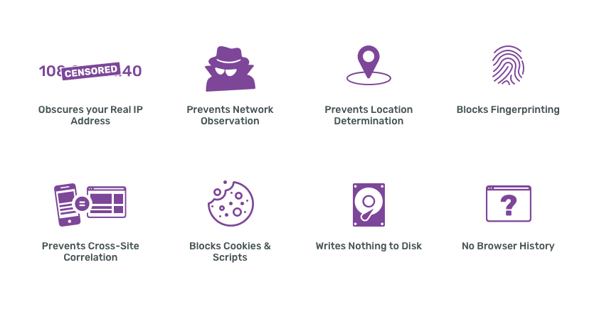

Slide 11
Why do we need Tor?

Slide 12
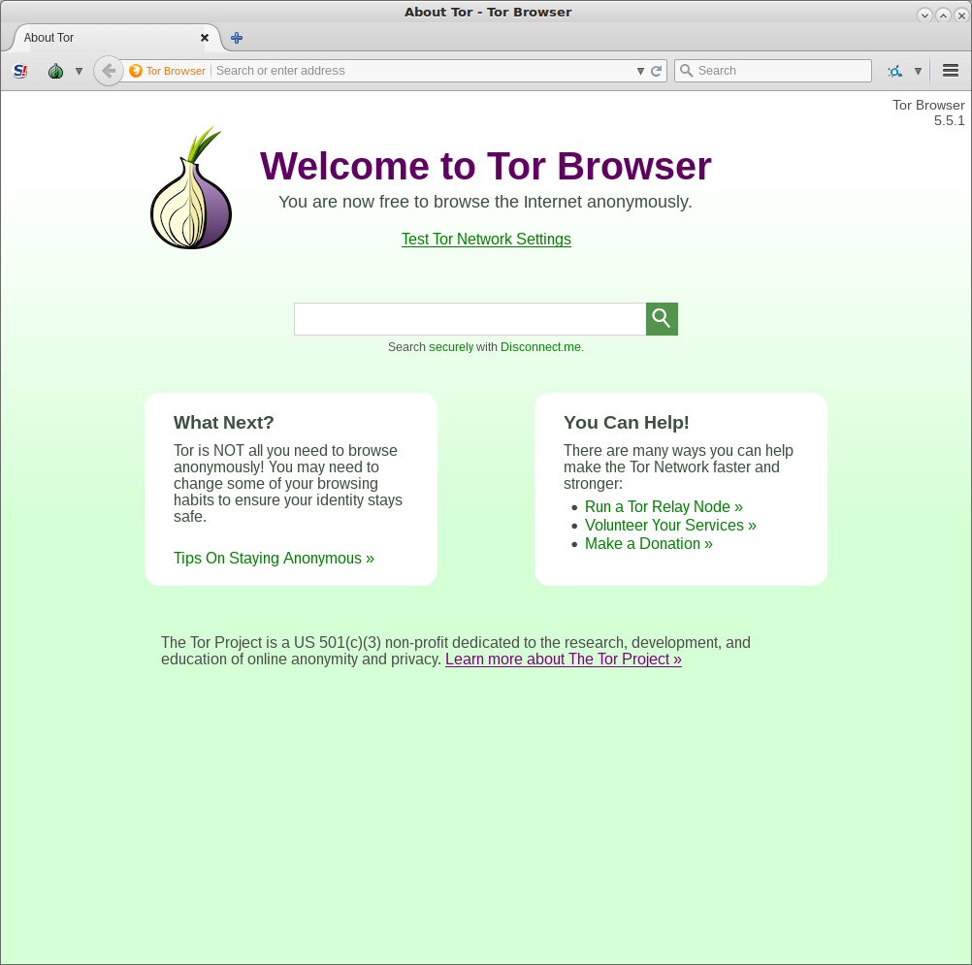
Tor Browser

Slide 13
Download Tor Browser
Go to torproject.org, follow prompts
What are your initial thoughts about the download process?
Any issues that come up?

Slide 14
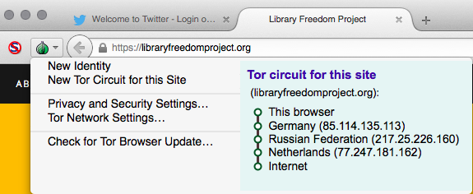
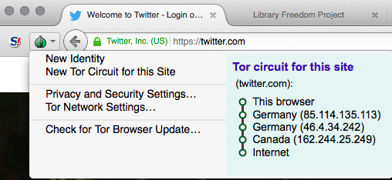
Clicking the onion menu will show your circuit (plus other options)

Slide 15
Using Tor Browser
Search engine: DuckDuckGo
Bundled with NoScript, HTTPS Everywhere
Do not add/enable any plugins (eg Flash)!
Best practices

Slide 16
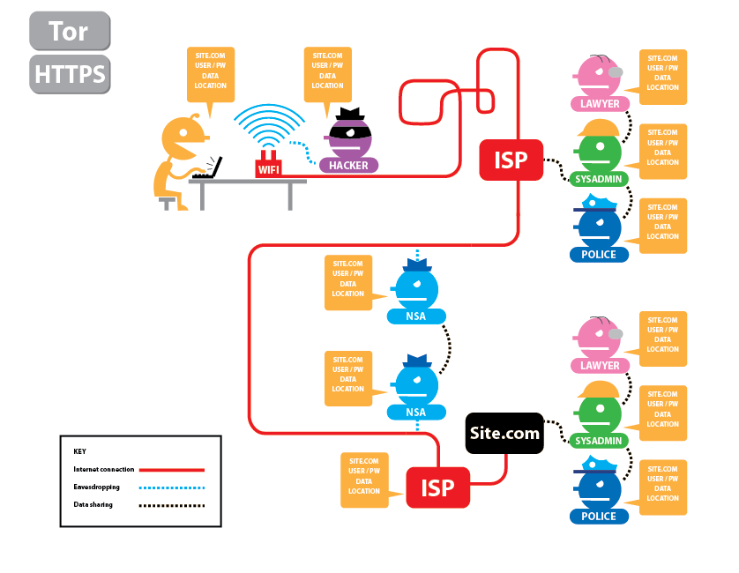
Who can see your activity without Tor or HTTPS?

Slide 17
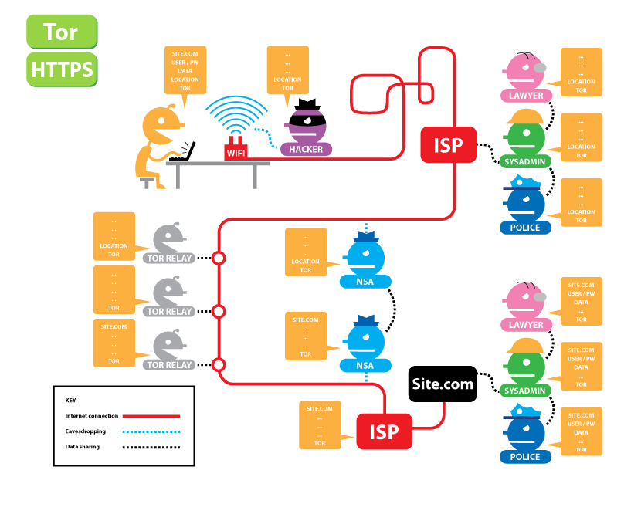
Who can see your activity with Tor and HTTPS?

Slide 18
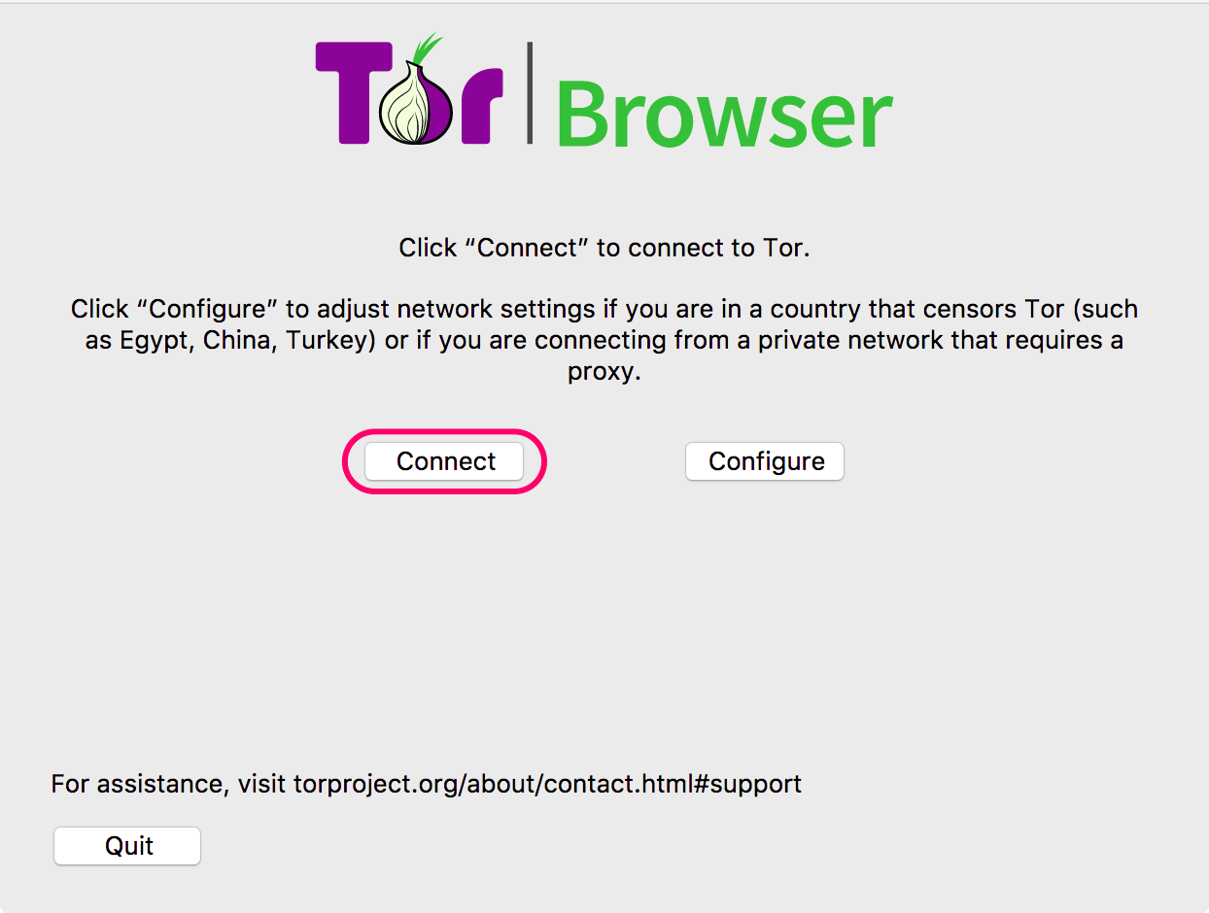
Running Tor Browser the first time

Slide 19
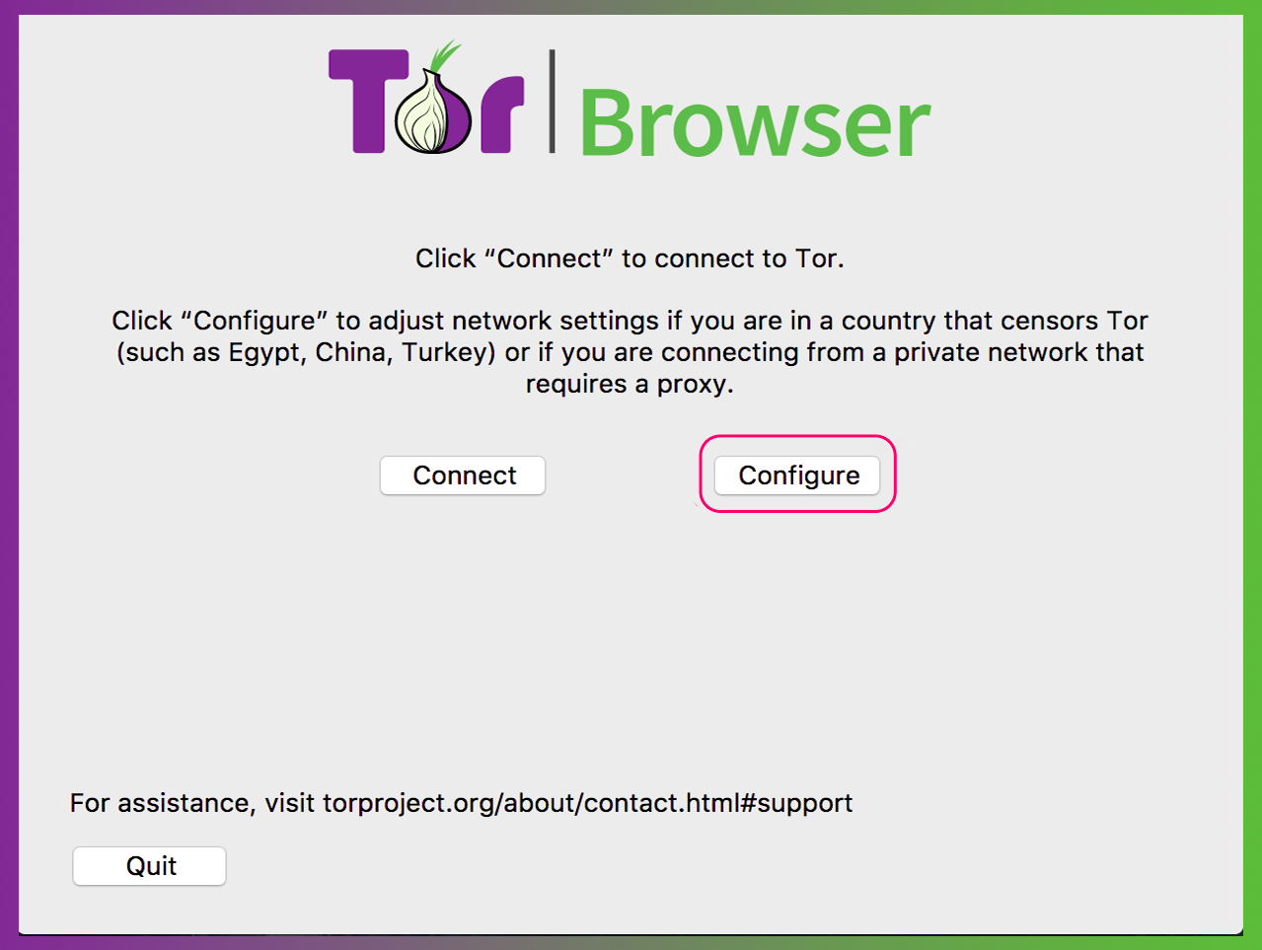
Running Tor Browser the first time

Slide 20
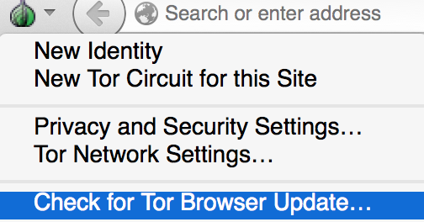
Updating Tor Browser

Slide 21
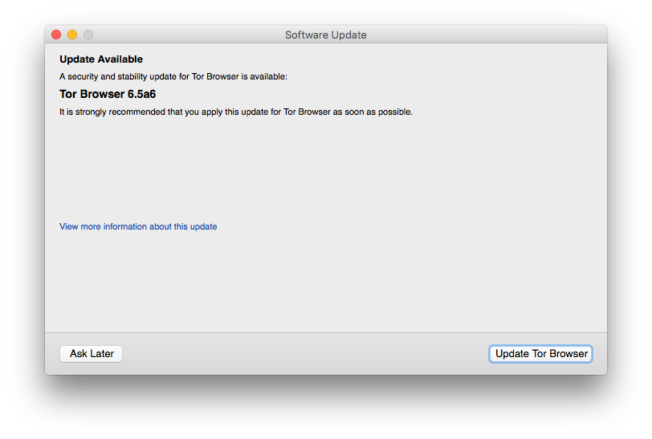
Updating Tor Browser

Slide 22
Uninstalling Tor Browser
Uninstalling Tor Browser is as easy as moving the folder to the trash! Then, empty the trash.
Default Tor Browser folder locations:
Windows: desktop
MacOS: applications folder
Linux: home, or look for a name like “tor-browser_en-US”

Slide 23
Troubleshooting Tor Browser
Is your system clock correct?
Is the browser already running?
Are you being censored?
Is your antivirus or firewall blocking Tor?
Do you have a very old operating system?
Try uninstalling and reinstalling

Slide 24
More Tor Browser

Slide 25
The “onion” menu
New Identity
New Tor circuit for this site: refreshes circuit just on that domain
Security settings: change slider
Tor network settings: censorship mitigation options; access to Tor log
Check for Tor Browser update

Slide 26
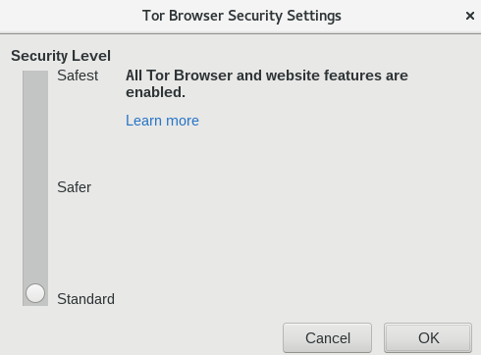
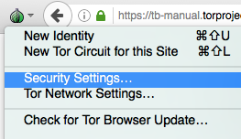
Security Slider

Slide 27
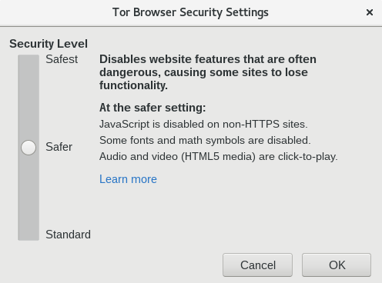
Security Slider

Slide 28
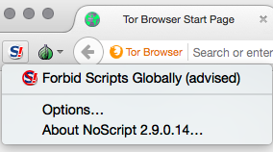
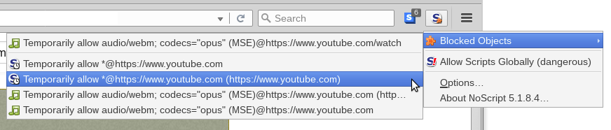
NoScript
Don’t change settings in the “options” menu
For example, adding sites to the “whitelist” can result in fingerprinting
Instead, only “temporarily allow” blocked objects
← don’t use!

Slide 29
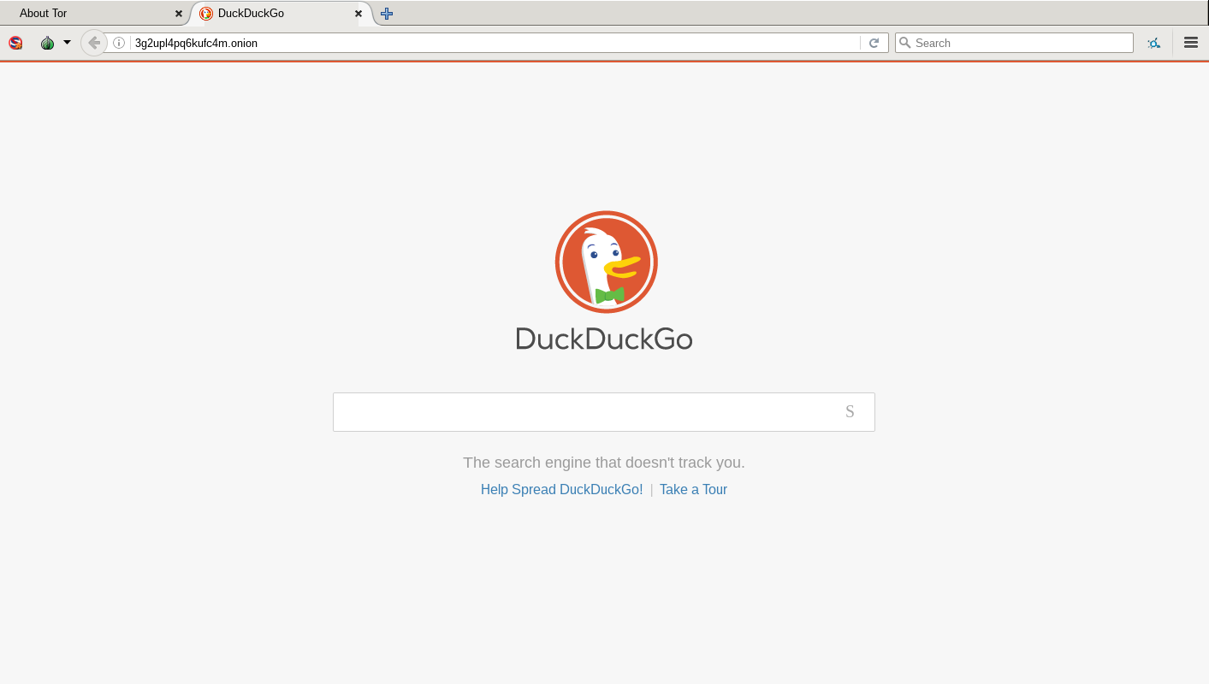
DuckDuckGo
DuckDuckGo is the default search engine in Tor Browser
Using Tor Browser prevents DDG from tracking users, even if they wanted to (they claim not to)
Duckduckgo.com or https://3g2upl4pq6kufc4m.onion/

Slide 30
Plugins, add-ons, Javascript
Do not add any new add-ons/extensions to Tor, and don’t enable any plugins
For example, Flash plugin can reveal your real location
Javascript is enabled by default, but is sanitized to preserve anonymity
To prevent possible Javascript vulnerabilities, use the “safest” setting in the security slider

Slide 31
Mobile Tor

Slide 32
Things to know about mobile Tor
The design of mobile devices makes full privacy impossible
Mobile Tor is best for censorship prevention
Can also provide better privacy for some threat models
We’re making it better all the time and better options for mobile devices are coming out soon

Slide 33
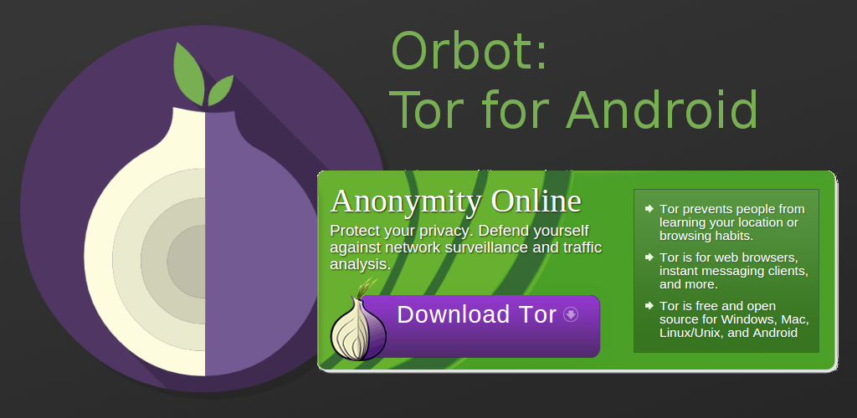
Orbot pic

Slide 34
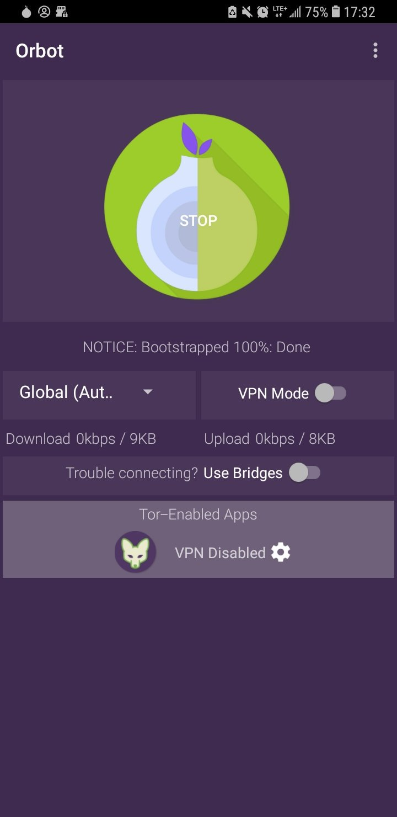
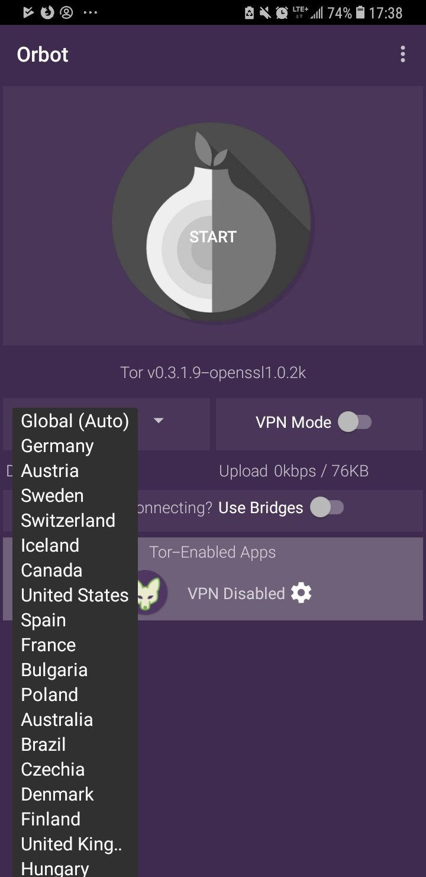
Using Orbot
Tor proxy for Android
Find it in the app store
Use it to run other apps through Tor (like Twitter)
Click start to run
You can choose your exit country if you want (some countries don’t have exits!)

Slide 35
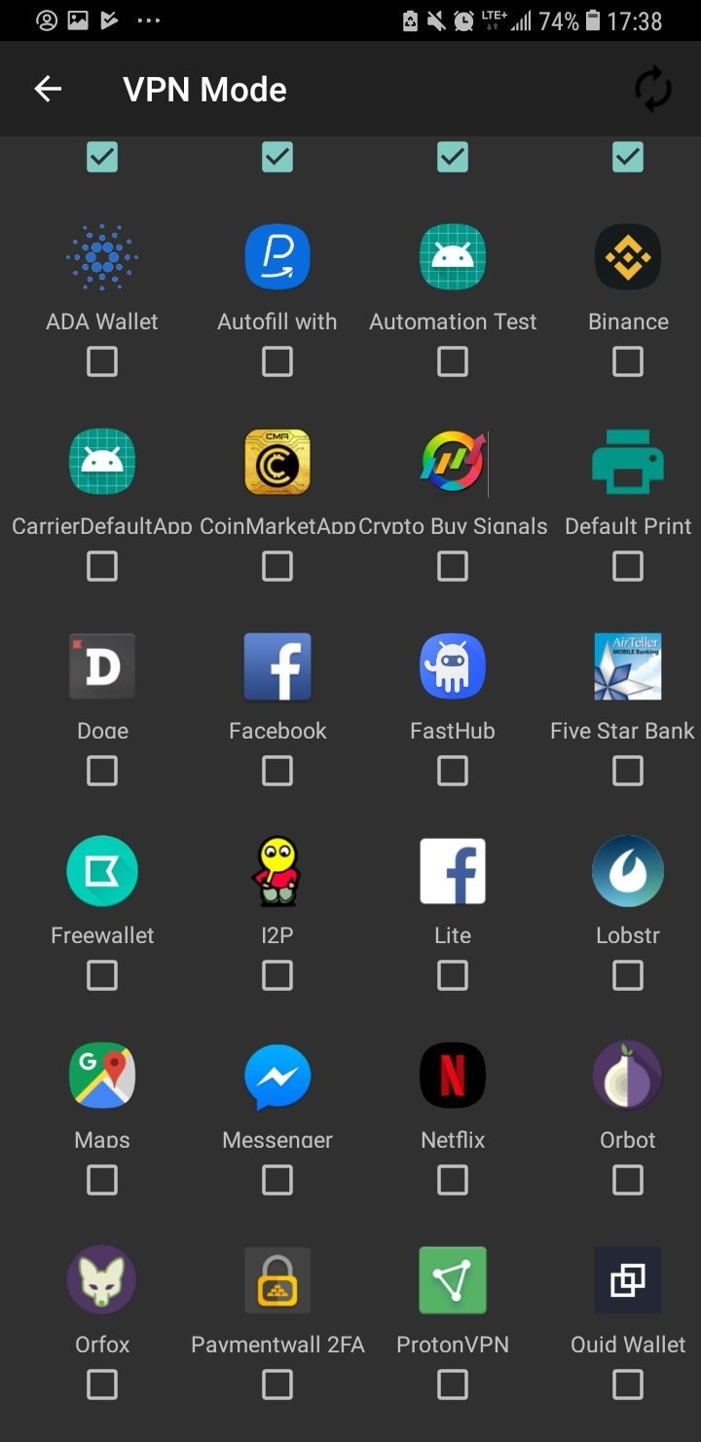
Using Orbot
Toggle “VPN mode” on main screen
Then click “Orbot-enabled apps”
Then select the apps you want to proxy with Tor

Slide 36
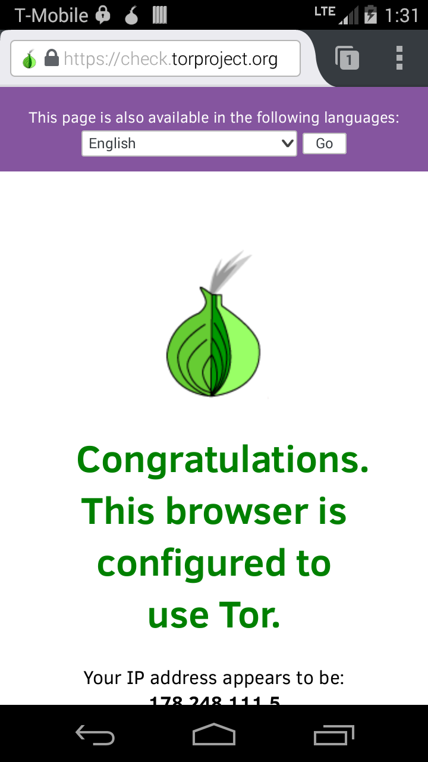
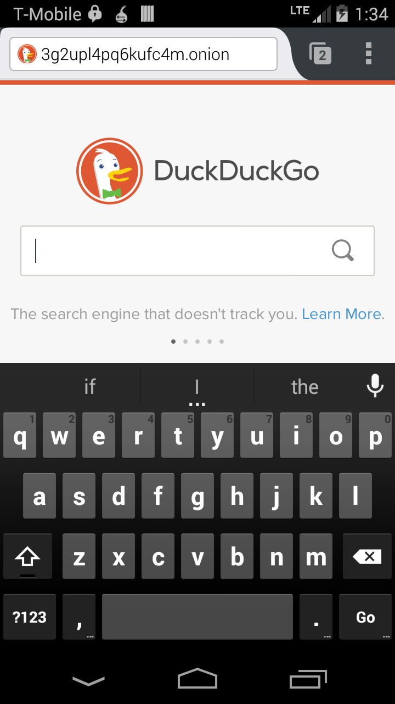
Using Orfox
Tor Browser for Android
You must have Orbot installed first
Find it in the app store

Slide 37
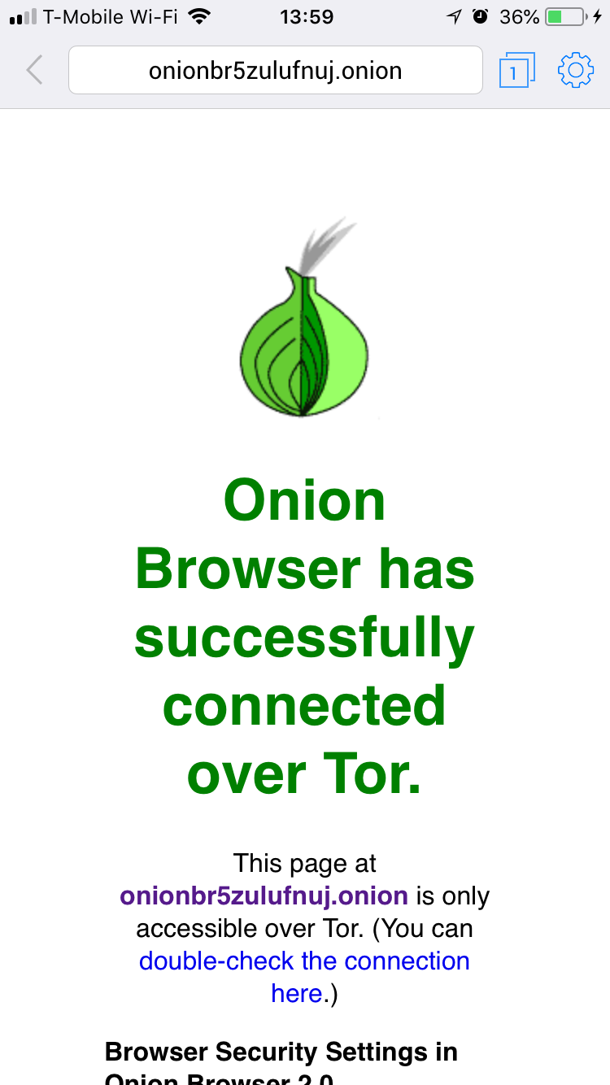
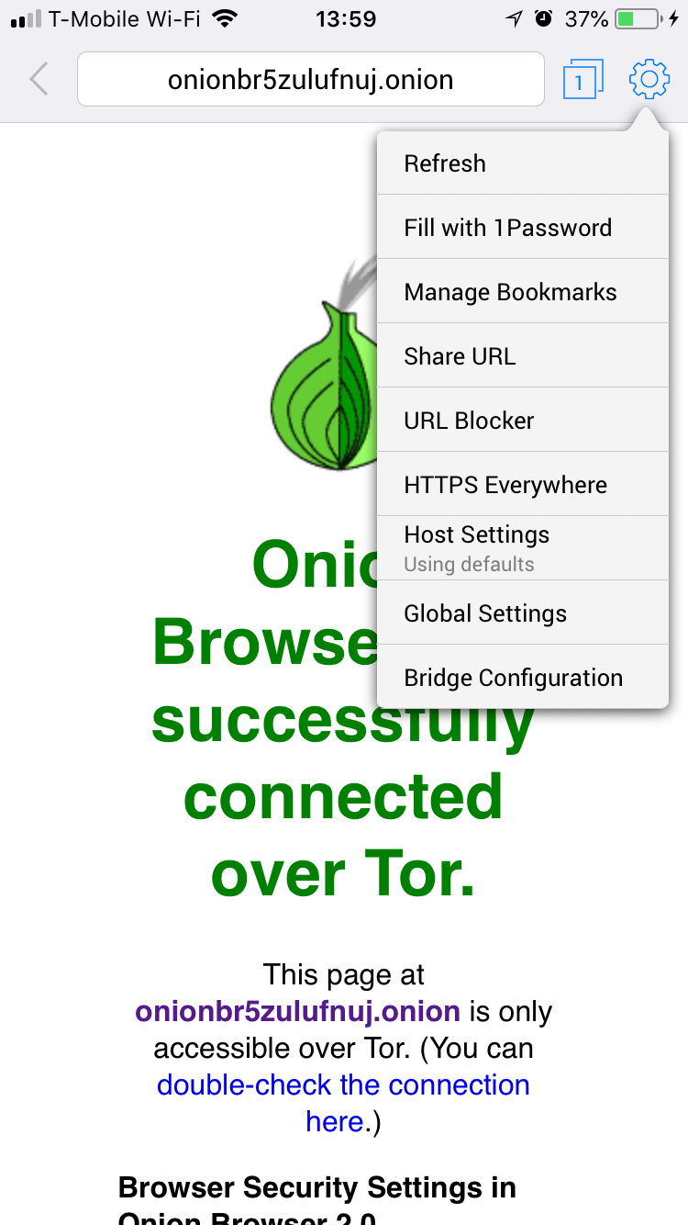
Onion Browser
Tor Browser for iOS
Find it in the app store
Lots of fake Tor Browsers in the iOS store
Very rudimentary
Crashes on sleep

Slide 38
How do I get help using Tor?

Slide 39
Help using Tor
Tor Browser Manual: tb-manual.torproject.org
(TB Manual is in 12 languages)
tor.stackexchange.com
Mailing lists (topic specific): lists.torproject.org
IRC: OFTC network, channel #tor
Easy access through webchat.oftc.net
Coming soon: support.torproject.org

Slide 40
If you find a bug in Tor
trac.torproject.org
Login as username “cypherpunks” passwords “writecode”
Search for your issue to find any existing tickets
If no ticket opened, open a new ticket with detailed description of the problem

Slide 41
What do you do when Tor is blocked?

Slide 42
When torproject.org is blocked
Mirrors
https://tor.eff.org/
http://tor.calyxinstitute.org/ (if https is blocked)
GetTor email: gettor@torproject.org
Contact from a Yahoo, Gmail, or Riseup account
Flash drive with Tor on it from someone you trust
Get the EXE, DMG, tar.xz, don’t copy the installed folder
Downloading Tor from a random website is dangerous!!!!!

Slide 43
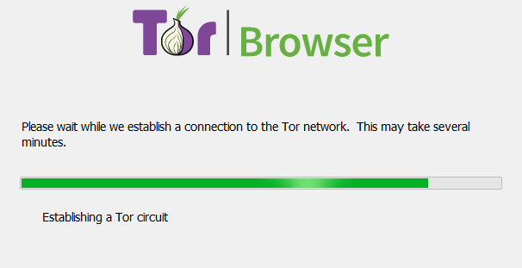
I downloaded Tor Browser, but it won’t connect
If this screen takes a long time and does not connect, you may need a bridge or pluggable transport

Slide 44
Bridges and pluggable transports
Bridges are relays that are not listed publicly
Get bridges from bridges.torproject.org
Or email bridges@torproject.org from a Gmail, Yahoo, or Riseup.net account
Pluggable transports can be used like bridges to disguise Tor traffic (also called “built-in bridges”)

Slide 45
Bridges and pluggable transports

Slide 46
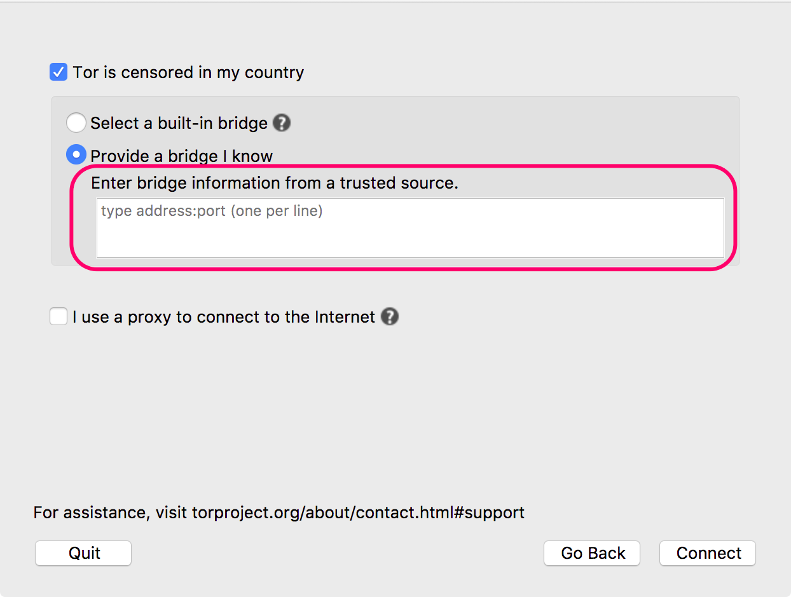
Bridges and pluggable transports

Slide 47
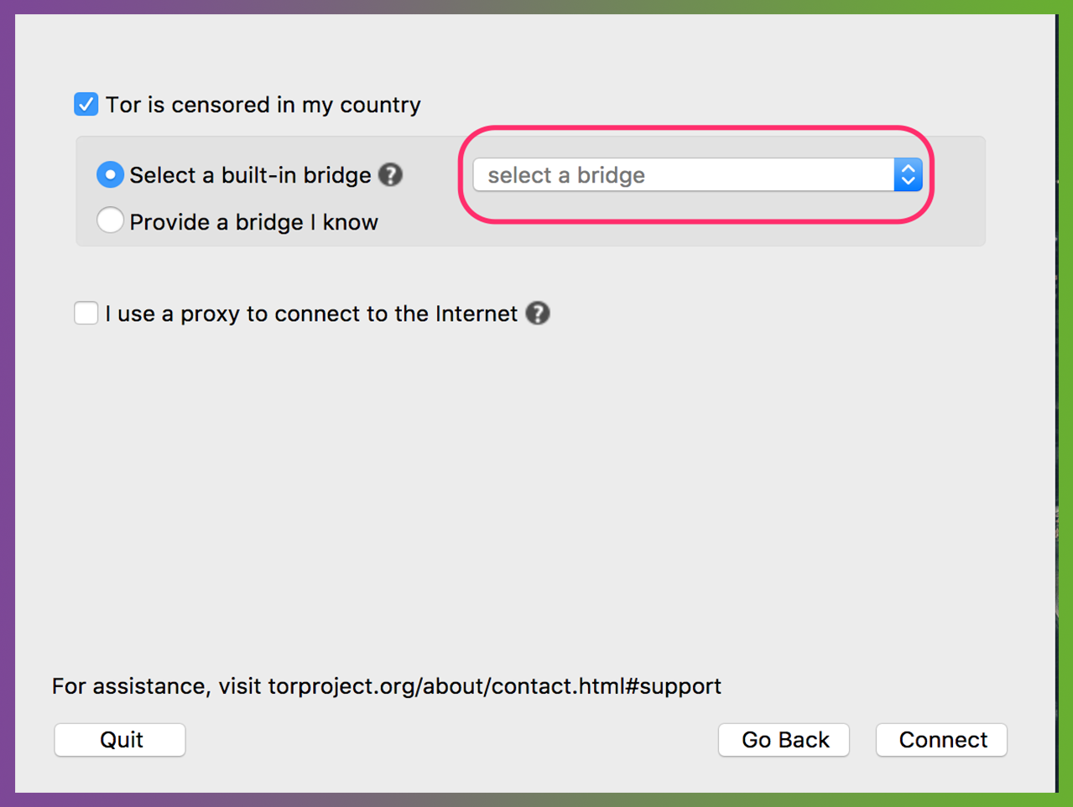
Bridges and pluggable transports

Slide 48
Pluggable transports
obfs4: makes Tor traffic look random; works in many situations including China (if not, try meek)
fte: makes Tor traffic look like regular HTTP traffic
meek-azure: makes it look like Microsoft traffic; works in China
obfs3: makes Tor traffic look random

Slide 49
Sharing content anonymously with Tor

Slide 50
Onion services
Protection for both the user and the server
User learns about xyz.onion
Client and service meet at rendezvous point in the Tor cloud
End-to-end encrypted without HTTPS
Connections never go out to the “vanilla” internet

Slide 51
OnionShare
Secure, private, anonymous file sharing done easy, built on top of the Tor network
Uses onion services to securely send files
Creates an onion service where the file can be downloaded
No need to trust third parties like Dropbox
Download from onionshare.org

Slide 52
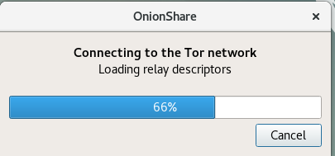
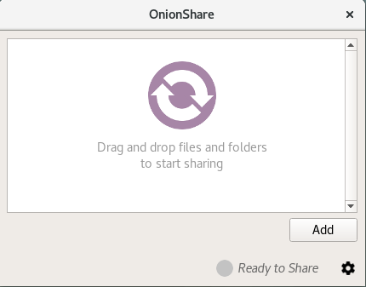
OnionShare connects to Tor network
Click “add” then find the file you want to share.

Slide 53
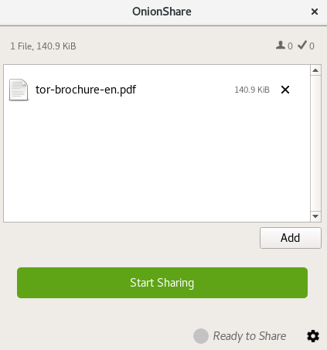
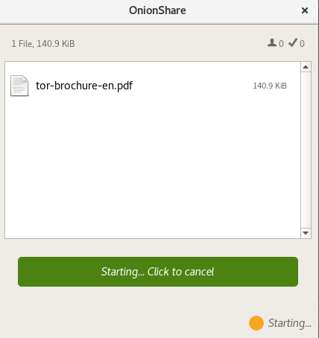
Once the file is added, click “start sharing”

Slide 54
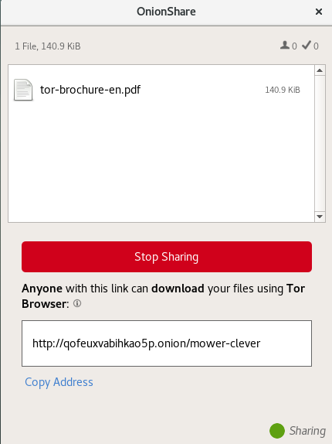
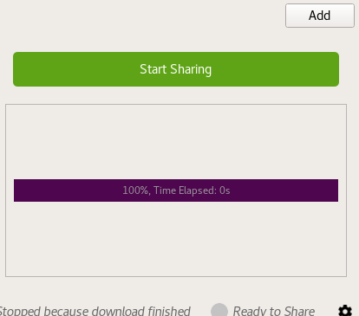
Copy the xyz.onion link and send it to your contact
Contact installs Tor Browser
When they finish downloading you’ll see this →

Slide 55
More Tor world
SecureDrop
Tails
OONI: Open Observatory of Network Interference
Brave Browser

Slide 56
SecureDrop
Tails
Brave Browser
Other Tor world stuff?

